Slide 1
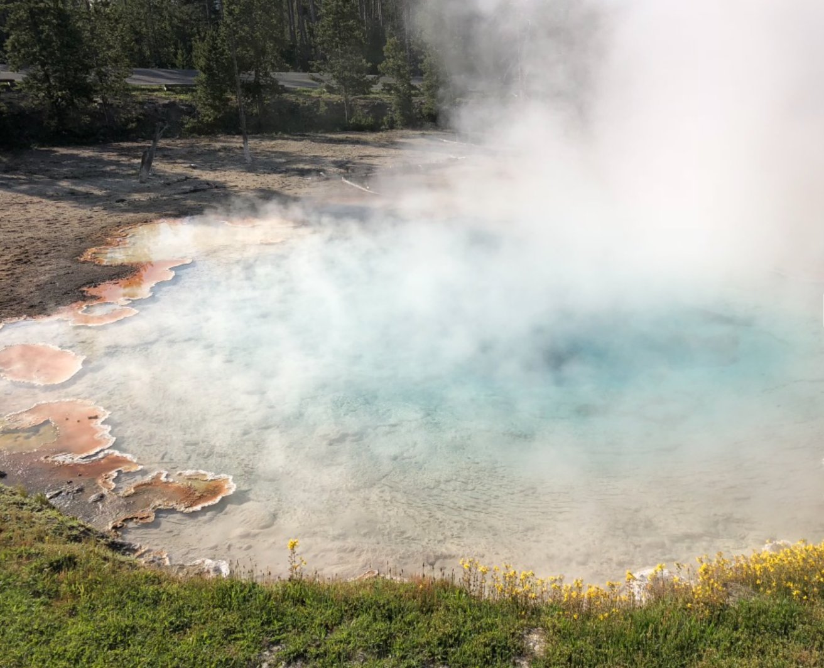
Confidence increasing!
Unit 7 – Confidence Interval Estimates
Your Mean SUPER NICE! Professor Colton

Slide 2
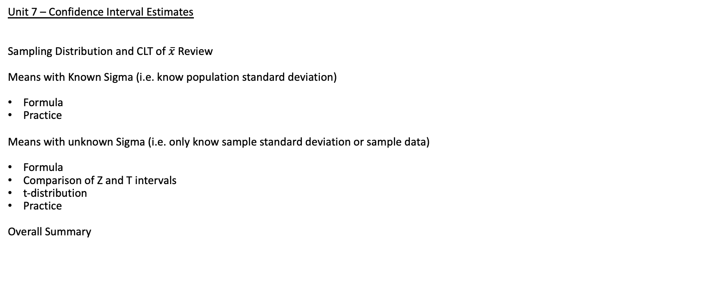
Unit 7, Day 2 - Outline
Unit 7 – Confidence Interval Estimates
Sampling Distribution and CLT of $\overline{x}$ Review
Means with Known Sigma (i.e. know population standard deviation)
Formula
Practice
Means with unknown Sigma (i.e. only know sample standard deviation or sample data)
Formula
Comparison of Z and T intervals
t-distribution
Practice
Overall Summary

Slide 3
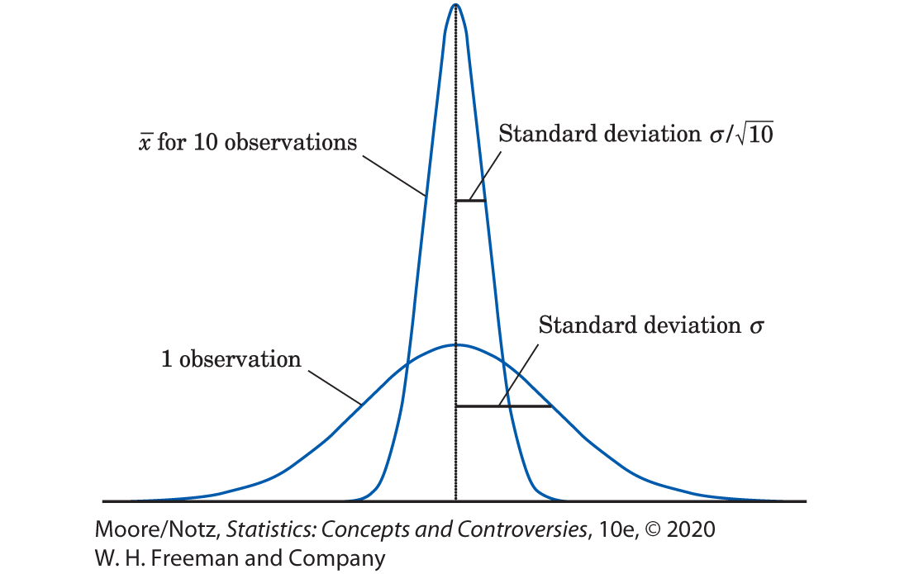

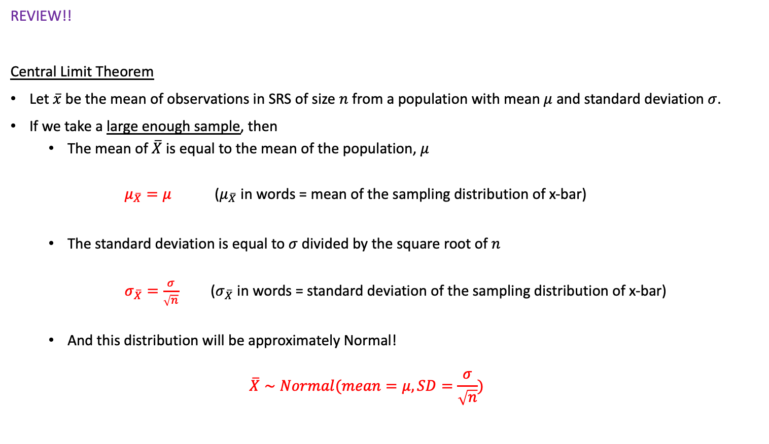
Central Limit Theorem (CLT) for $\overline{x}$
Sampling Dist
Population Dist
REVIEW!!
Central Limit Theorem
Let $\overline{x}$ be the mean of observations in SRS of size $n$ from a population with mean $μ$ and standard deviation $σ$.
If we take a large enough sample, then
The mean of $\overline{X}$ is equal to the mean of the population, $μ$
$μ_{\overline{X}}=μ$ ($μ_{\overline{X}}$ in words = mean of the sampling distribution of x-bar)
The standard deviation is equal to $σ$ divided by the square root of $n$
$σ_{\overline{X}}=\frac{σ}{\sqrt{n}}$ ($σ_{\overline{X}}$ in words = standard deviation of the sampling distribution of x-bar)
And this distribution will be approximately Normal!
$$\overline{X}∼Normal(mean=μ, SD=\frac{σ}{\sqrt{n}})$$
Summary
If X has mean µ and sd $σ$
(Referring to the population, selecting a single person)
$\overline{X}$ is Normal with mean $μ_{\overline{X}}=μ$ and SD $σ_{\overline{X}}=\frac{σ}{\sqrt{n}}$
(Referring to the sampling distribution, selecting a group of people and summarizing)

Slide 4
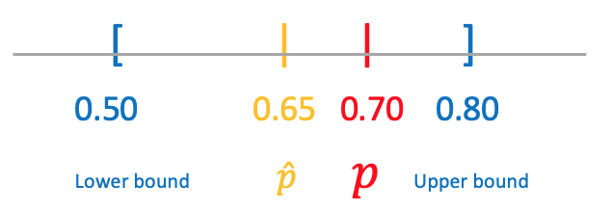
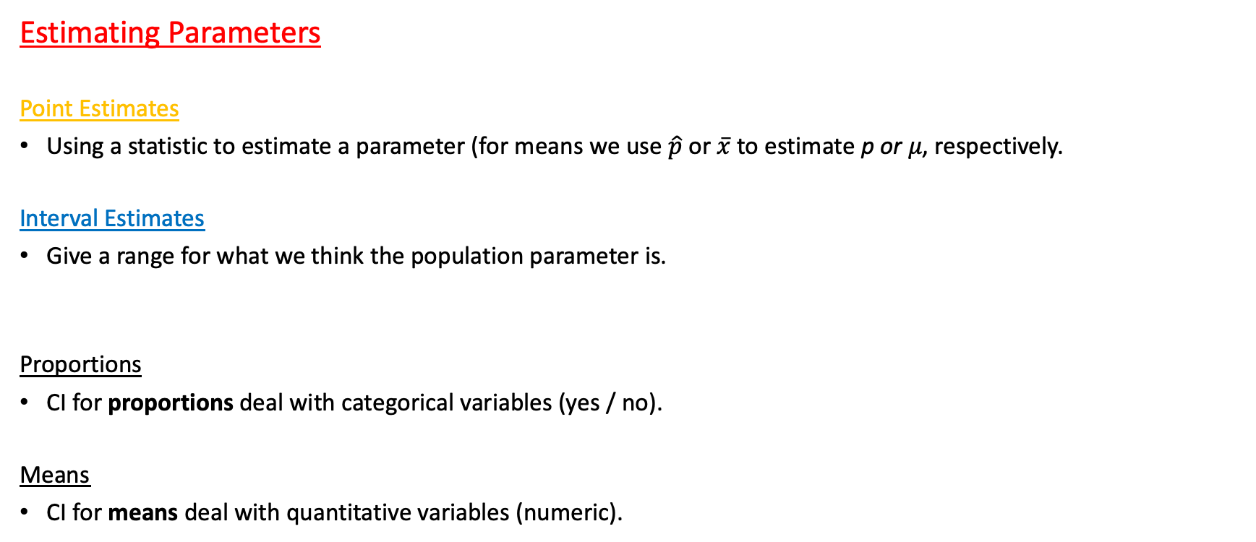
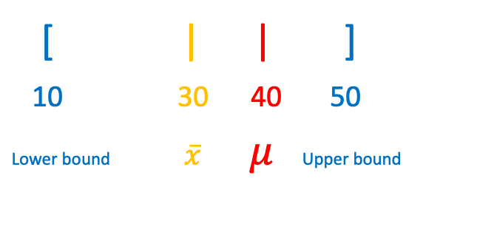
Confidence Intervals Again!
Estimating Parameters
Point Estimates
Using a statistic to estimate a parameter (for means we use $\hat{p}$ or $\overline{x}$ to estimate p or 𝜇, respectively.
Interval Estimates
Give a range for what we think the population parameter is.
Proportions
CI for proportions deal with categorical variables (yes / no).
Means
CI for means deal with quantitative variables (numeric).
[ | | ]
10 30 40 50
Lower bound $\overline{x} μ$Upper bound

Slide 5
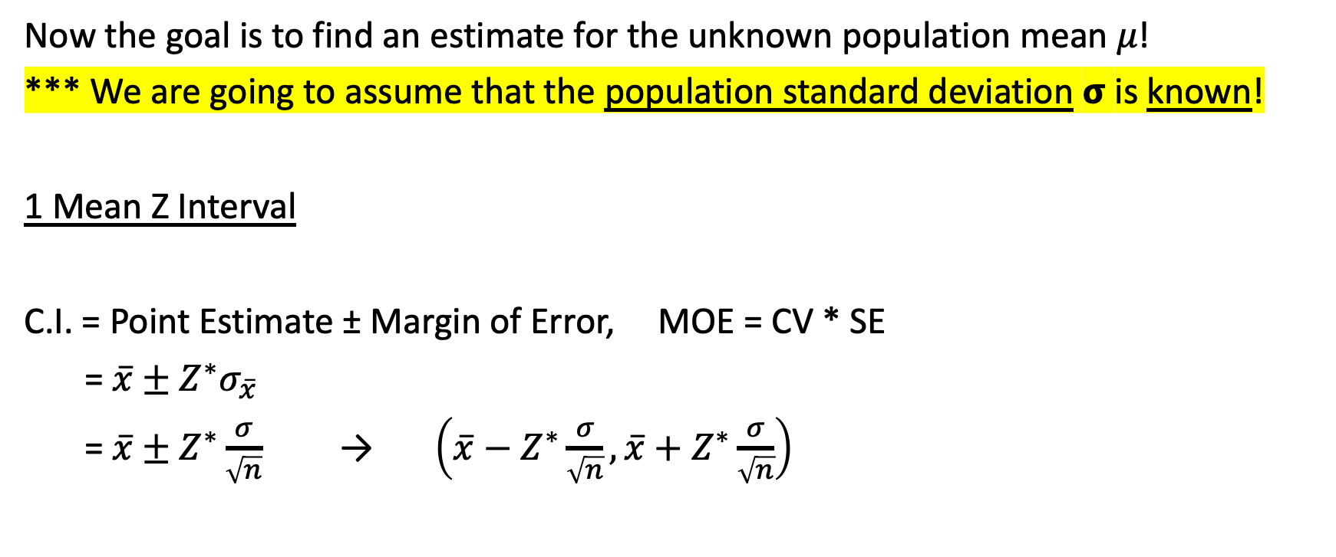
Final Confidence Interval for 𝜇
Now the goal is to find an estimate for the unknown population mean 𝜇!
*** We are going to assume that the population standard deviation 𝞂 is known!
1 Mean Z Interval
C.I. = Point Estimate ± Margin of Error, MOE = CV * SE
= $\overline{x}±Z^{∗}σ_{\overline{x}}$
= $\overline{x}±Z^{∗}\frac{σ}{\sqrt{n}}$ → $\left(\overline{x}−Z^{∗}\frac{σ}{\sqrt{n}},\overline{x}+Z^{∗}\frac{σ}{\sqrt{n}}\right)$
* Same Critical Value as with a 1 Proportion Z Interval
Same interpretation too!!
I am % confident that the true/population parameter + context is between (lower bound) and (upper bound).

Slide 6
Using Calc!
Setup
Suppose the number of points scored by your favorite basketball team is normally distribution with known population standard deviation 𝞂 = 15 points.
The mean from a random sample of 35 games was 72 points. Calculate and interpret the corresponding 95% confidence interval!
GOAL: Find the Confidence Interval!
ZInterval
Input = Stats
𝞂 = population standard deviation
$\overline{x}$ = sample mean
n = sample size
C-Level = Confidence level (as a decimal or whole number, both work)
Interpret results:
??

Slide 7
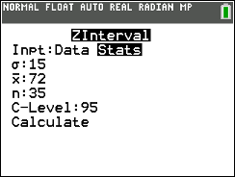
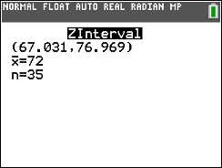
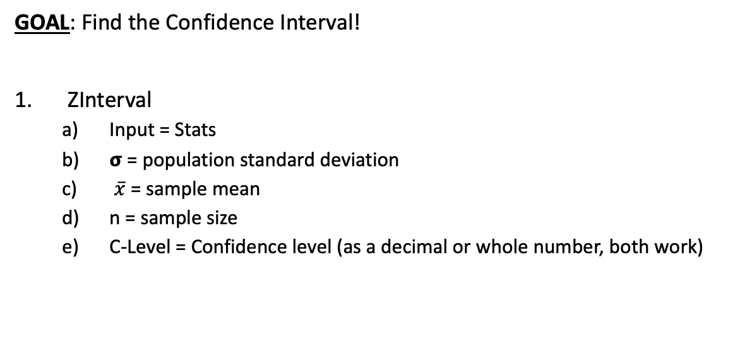
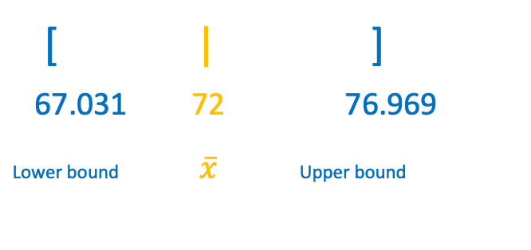
Using Calc!
Setup
Suppose the number of points scored by your favorite basketball team is normally distribution with known population standard deviation 𝞂 = 15 points.
The mean from a random sample of 35 games was 72 points. Calculate and interpret the corresponding 95% confidence interval!
GOAL: Find the Confidence Interval!
ZInterval
Input = Stats
𝞂 = population standard deviation
$\overline{x}$ = sample mean
n = sample size
C-Level = Confidence level (as a decimal or whole number, both work)
[ | ]
67.031 72 76.969
Lower bound $\overline{x}$Upper bound
Show work: 95% CI = ZInterval(𝞂 = 15, $\overline{x}$ = 72, n = 35, C-Level = 95) → (67.031, 76.969)
Interpret results:
We are 95% confident that the true mean number of points scored by my favorite basketball team is between 67.031 and 76.969

Slide 8

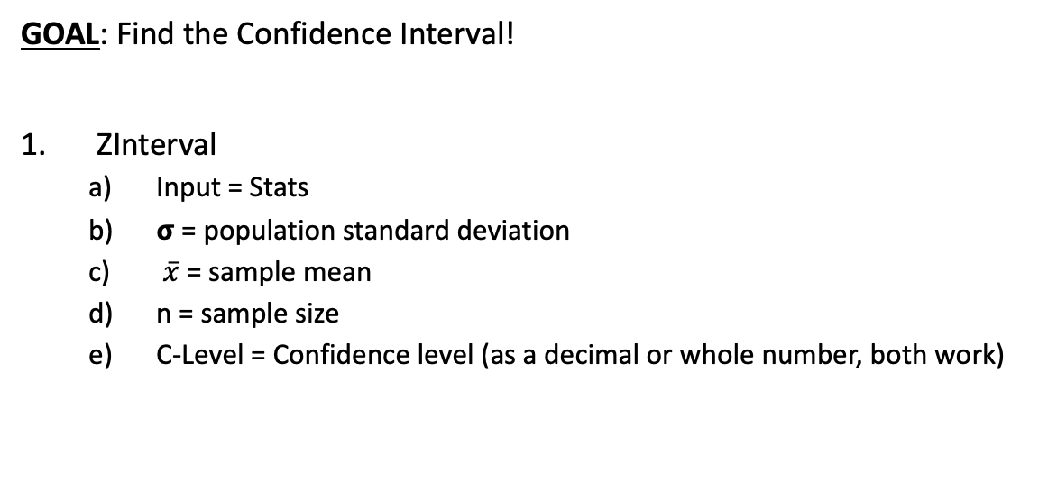



Using Calc!
Setup
Suppose the number of points scored by your favorite basketball team is normally distribution with known population standard deviation 𝞂 = 15 points.
The mean from a random sample of 35 games was 72 points and SAMPLE standard deviation of 12 points. Calculate and interpret the corresponding 95% confidence interval!
GOAL: Find the Confidence Interval!
ZInterval
Input = Stats
𝞂 = population standard deviation
$\overline{x}$ = sample mean
n = sample size
C-Level = Confidence level (as a decimal or whole number, both work)
[ | ]
67.031 72 76.969
Lower bound $\overline{x}$Upper bound
Show work: ZInterval(Input = Stats, sigma = 15, x-bar = 72, n = 35, C-Level = 0.95) = (67.031, 76.969)
Interpret results:
My favorite basketball team scored an average of between 67 points and 76 points with a 95% confidence level
The true mean points scored per game is between 67 points and 76 points with a 95% confidence level
My belief my guess of where this unknown population mean is, context, the actual numbers we calculated, some confidence statement
b) I'm 95% confident that the true population sample MEAN (PARAMETER) of the number of points scored on my favorite basketball team was 72 points between 67 and 76 points

Slide 9
Another LCQ
Setup: Lets assume the population of ACT scores is normally distribution with known population standard deviation 𝞂 = 3.5 points. From a random sample of 15 students, there was a sample mean score of 24.
1) Calculate the 85% Confidence Interval
2) Interpret this interval.

Slide 10
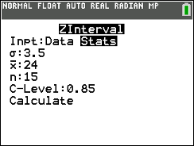

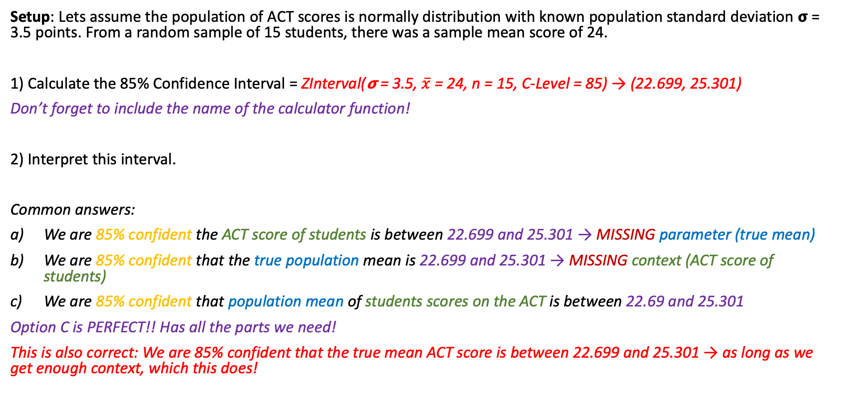
Another LCQ
Setup: Lets assume the population of ACT scores is normally distribution with known population standard deviation 𝞂 = 3.5 points. From a random sample of 15 students, there was a sample mean score of 24.
1) Calculate the 85% Confidence Interval = ZInterval(𝞂 = 3.5, $\overline{x}$ = 24, n = 15, C-Level = 85) → (22.699, 25.301)
Don’t forget to include the name of the calculator function!
2) Interpret this interval.
Common answers:
We are 85% confident the ACT score of students is between 22.699 and 25.301 → MISSING parameter (true mean)
We are 85% confident that the true population mean is 22.699 and 25.301 → MISSING context (ACT score of students)
We are 85% confident that population mean of students scores on the ACT is between 22.69 and 25.301
Option C is PERFECT!! Has all the parts we need!
This is also correct: We are 85% confident that the true mean ACT score is between 22.699 and 25.301 → as long as we get enough context, which this does!
There is NO NEED TO BE CREATIVE!!
Use the general format, that is what I am expecting and what will get full credit!

Slide 11
One more LCQ
Setup: Suppose an instructor wishes to predict the average time needed to take the final exam. A random sample of 45 students shows a mean of 1.4 hours. The population standard deviation is known to be 0.25 hours.
Calculate and interpret the 97% Confidence Interval.
If I increase the sample size to 60, find the margin of error of the new CI. Is it smaller or larger than the MOE in (1)?
If we were mistaken and the actual population standard deviation is 0.75 hours. With a sample size of 45, will a 97% CI be wider or narrower than the result in (1)? Find the new interval.

Slide 12
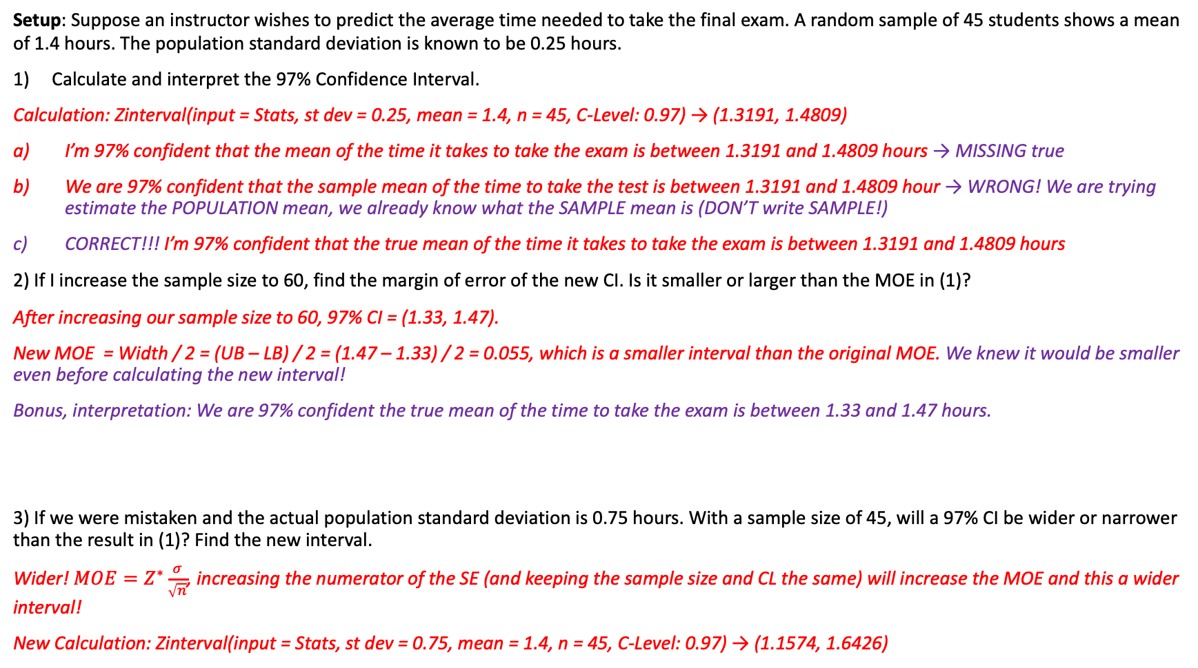
One more LCQ
Setup: Suppose an instructor wishes to predict the average time needed to take the final exam. A random sample of 45 students shows a mean of 1.4 hours. The population standard deviation is known to be 0.25 hours.
Calculate and interpret the 97% Confidence Interval.
Calculation: Zinterval(input = Stats, st dev = 0.25, mean = 1.4, n = 45, C-Level: 0.97) → (1.3191, 1.4809)
I’m 97% confident that the mean of the time it takes to take the exam is between 1.3191 and 1.4809 hours → MISSING true
We are 97% confident that the sample mean of the time to take the test is between 1.3191 and 1.4809 hour → WRONG! We are trying estimate the POPULATION mean, we already know what the SAMPLE mean is (DON’T write SAMPLE!)
CORRECT!!! I’m 97% confident that the true mean of the time it takes to take the exam is between 1.3191 and 1.4809 hours
2) If I increase the sample size to 60, find the margin of error of the new CI. Is it smaller or larger than the MOE in (1)?
After increasing our sample size to 60, 97% CI = (1.33, 1.47).
New MOE = Width / 2 = (UB – LB) / 2 = (1.47 – 1.33) / 2 = 0.055, which is a smaller interval than the original MOE. We knew it would be smaller even before calculating the new interval!
Bonus, interpretation: We are 97% confident the true mean of the time to take the exam is between 1.33 and 1.47 hours.
3) If we were mistaken and the actual population standard deviation is 0.75 hours. With a sample size of 45, will a 97% CI be wider or narrower than the result in (1)? Find the new interval.
Wider! $MOE=Z^{∗}\frac{σ}{\sqrt{n}}$, increasing the numerator of the SE (and keeping the sample size and CL the same) will increase the MOE and this a wider interval!
New Calculation: Zinterval(input = Stats, st dev = 0.75, mean = 1.4, n = 45, C-Level: 0.97) → (1.1574, 1.6426)
SHOW YOUR WORK! For calculating an interval, that means writing the name of the procedure and the inputs!

Slide 13

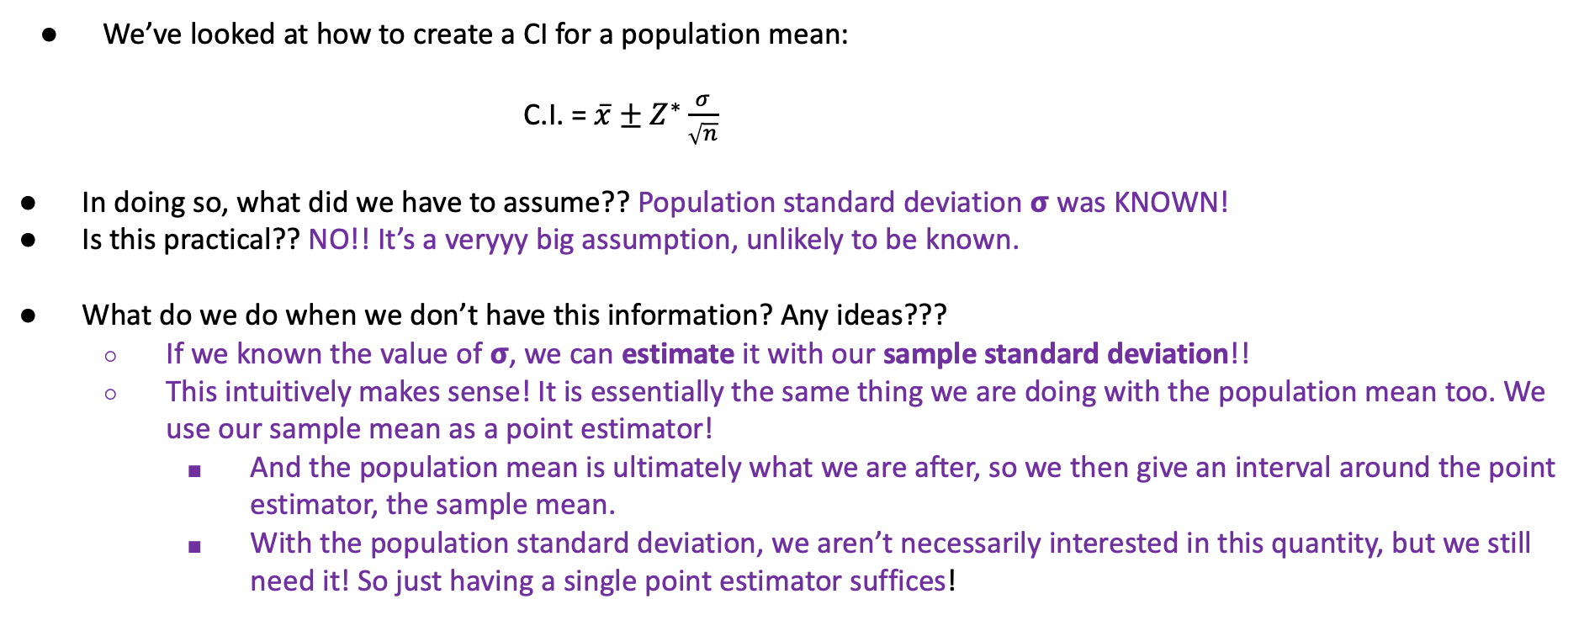
A New CI for a New Unknown
We’ve looked at how to create a CI for a population mean:
C.I. = $\overline{x}±Z^{∗}\frac{σ}{\sqrt{n}}$
In doing so, what did we have to assume?? Population standard deviation 𝞂 was KNOWN!
Is this practical?? NO!! It’s a veryyy big assumption, unlikely to be known.
What do we do when we don’t have this information? Any ideas???
If we known the value of 𝞂, we can estimate it with our sample standard deviation!!
This intuitively makes sense! It is essentially the same thing we are doing with the population mean too. We use our sample mean as a point estimator!
And the population mean is ultimately what we are after, so we then give an interval around the point estimator, the sample mean.
With the population standard deviation, we aren’t necessarily interested in this quantity, but we still need it! So just having a single point estimator suffices!

Slide 14
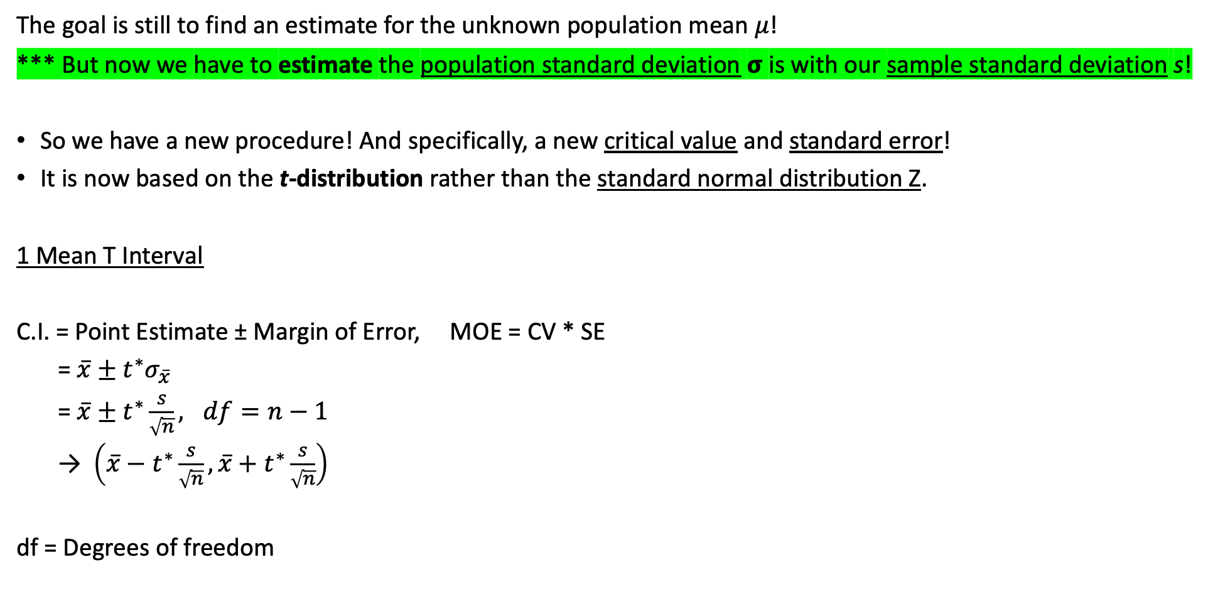
Final Confidence Interval for 𝜇, unknown 𝞂!
The goal is still to find an estimate for the unknown population mean 𝜇!
*** But now we have to estimate the population standard deviation 𝞂 is with our sample standard deviation s!
So we have a new procedure! And specifically, a new critical value and standard error!
It is now based on the t-distribution rather than the standard normal distribution Z.
1 Mean T Interval
C.I. = Point Estimate ± Margin of Error, MOE = CV * SE
= $\overline{x}±t^{∗}σ_{\overline{x}}$
= $\overline{x}±t^{∗}\frac{s}{\sqrt{n}}, df=n−1$
→ $\left(\overline{x}−t^{∗}\frac{s}{\sqrt{n}},\overline{x}+t^{∗}\frac{s}{\sqrt{n}}\right)$
df = Degrees of freedom
This is wayyy more common than a Z Interval!
Still same interpretation!!
I am % confident that the true/population parameter + context is between (lower bound) and (upper bound).

Slide 15
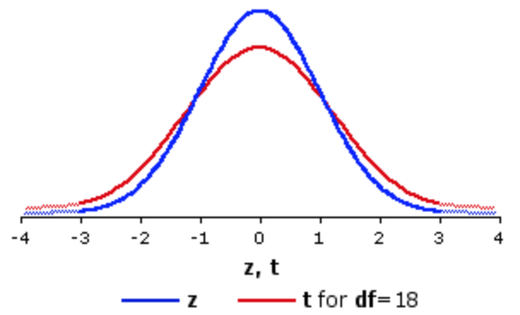
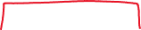
CIs for Known vs Unknown 𝞂
Because we have to estimate an extra parameter, there is inherently more variability in a t-interval!
This makes sense! Sample means vary from sample to sample, so do the standard deviations!
So to account for that extra level of uncertainty, t-intervals produce wider intervals compared to Z-intervals (for the same confidence level and sample size).
95% C
95% C
t-interval
95% C
95% C
Z-interval
Z* < t*
Z-interval is the GOLD standard (more precise, which is great!), so we want to do this procedure IF WE CAN
But if not and we only have the SAMPLE STANDARD DEVIATION, then we have to do T-Interval
http://vassarstats.net/textbook/ch9pt3.html

Slide 16
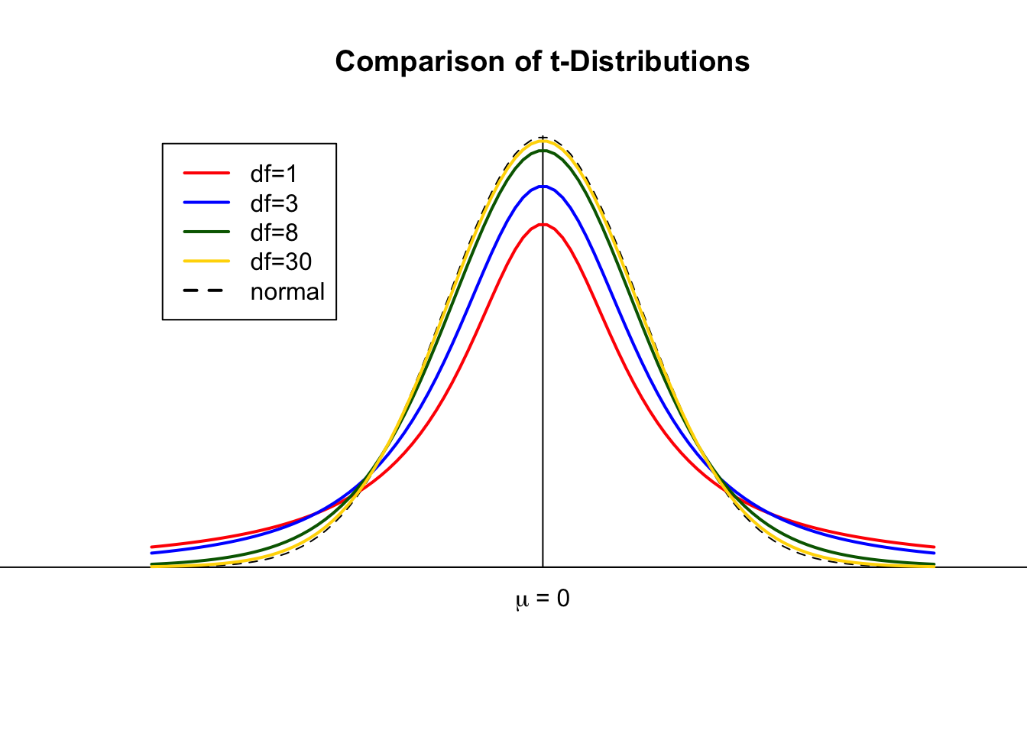
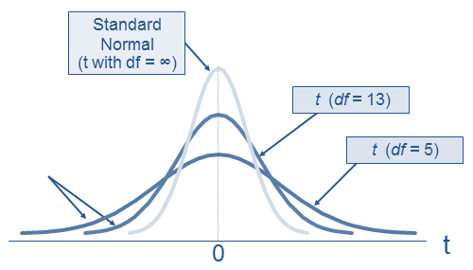
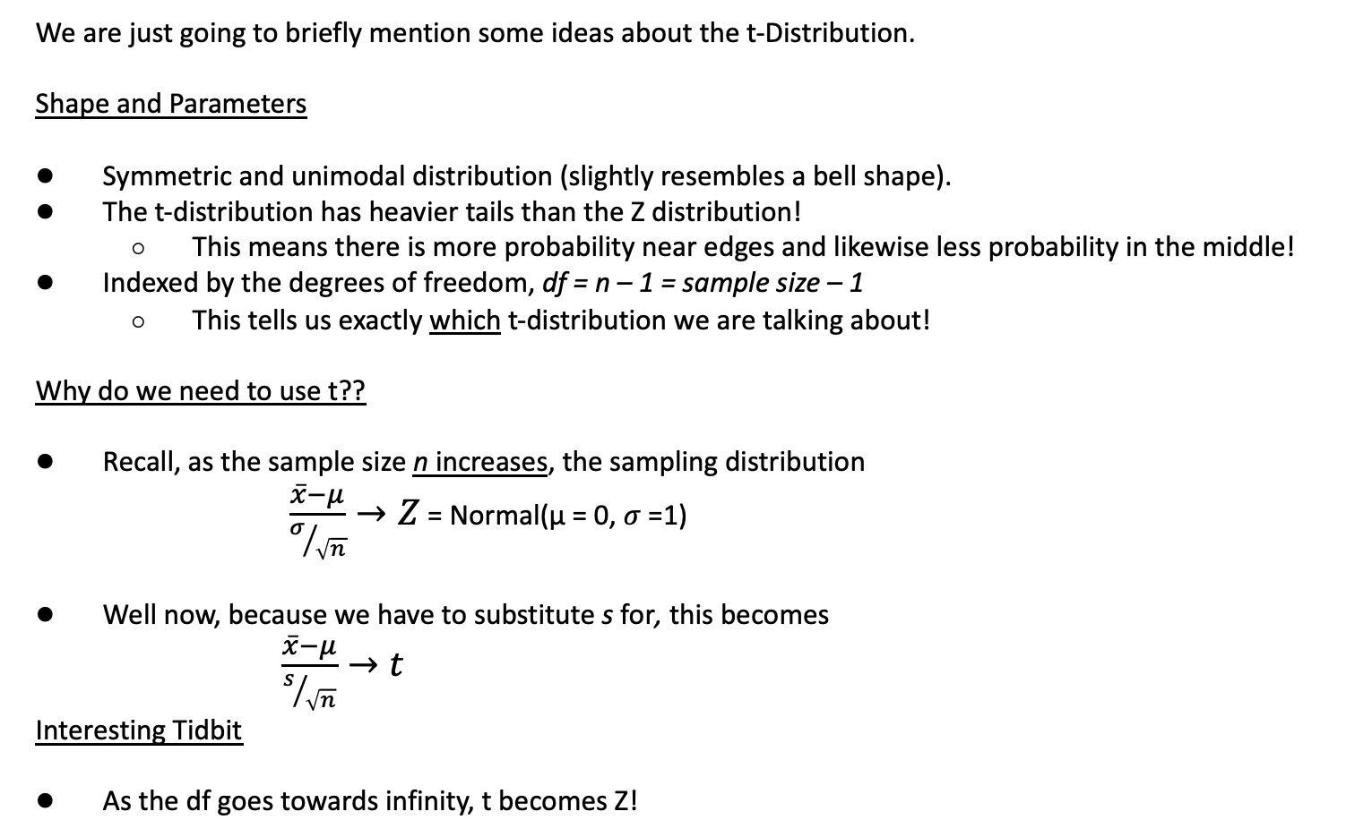
t-Distribution
https://www.geo.fu-berlin.de
We are just going to briefly mention some ideas about the t-Distribution.
Shape and Parameters
Symmetric and unimodal distribution (slightly resembles a bell shape).
The t-distribution has heavier tails than the Z distribution!
This means there is more probability near edges and likewise less probability in the middle!
Indexed by the degrees of freedom, df = n – 1 = sample size – 1
This tells us exactly which t-distribution we are talking about!
Why do we need to use t??
Recall, as the sample size n increases, the sampling distribution
$\frac{\overline{x}−μ}{σ/{\sqrt{n}}}→Z$ = Normal(µ = 0, $σ$ =1)
Well now, because we have to substitute s for, this becomes
$\frac{\overline{x}−μ}{s/{\sqrt{n}}}→t$
Interesting Tidbit
As the df goes towards infinity, t becomes Z!
https://financetrain.com/students-t-distribution-2
Doper applet!

Slide 17
USE T WHEN DON’T KNOW SIGMA
PRODUCES WIDER INTERVALS THAN Z FOR THE SAME CONFIDENCE
FOCUSING ON APPLICATION
KNOWING WHEN TO USE WHAT AND HOW TO LET CALC DO IT

Slide 18
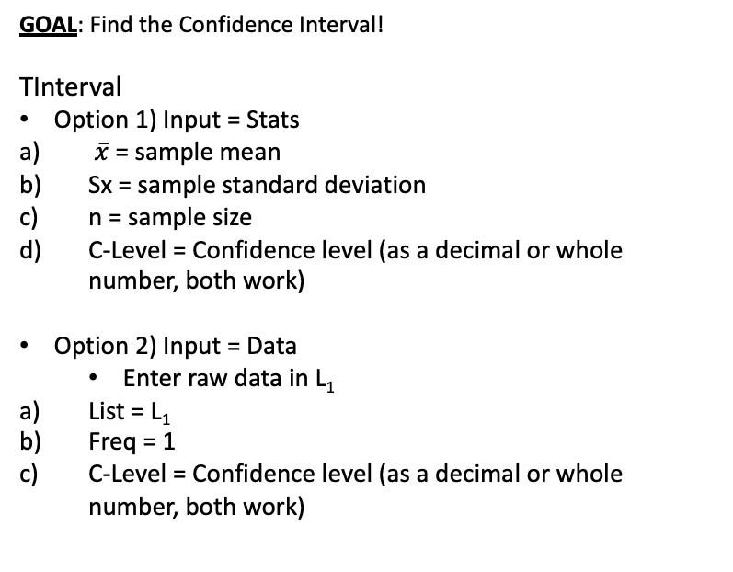
Using Calc!
Setup
Lets assume the population of SAT scores is normally distribution with unknown population standard deviation.
From a random sample of 6 students, there was a sample mean score of 1190 and sample standard deviation of 205.91 points. Calculate and interpret the corresponding 95% confidence interval!
GOAL: Find the Confidence Interval!
TInterval
Option 1) Input = Stats
$\overline{x}$ = sample mean
Sx = sample standard deviation
n = sample size
C-Level = Confidence level (as a decimal or whole number, both work)
Option 2) Input = Data
Enter raw data in L₁
List = L₁
Freq = 1
C-Level = Confidence level (as a decimal or whole number, both work)
Interpret results:
??

Slide 19
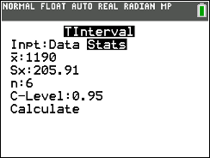
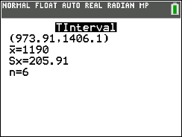
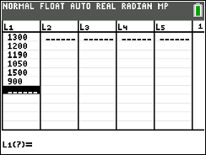
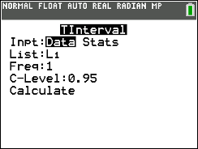
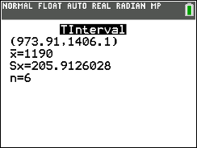
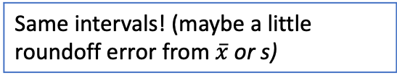
Using Calc!
Setup
Lets assume the population of SAT scores is normally distribution with unknown population standard deviation.
From a random sample of 6 students, there was a sample mean score of 1190 and sample standard deviation of 205.91 points. Calculate and interpret the corresponding 95% confidence interval!
GOAL: Find the Confidence Interval!
TInterval
Option 1) Input = Stats
$\overline{x}$ = sample mean
Sx = sample standard deviation
n = sample size
C-Level = Confidence level (as a decimal or whole number, both work)
Option 2) Input = Data
Enter raw data in L₁
List = L₁
Freq = 1
C-Level = Confidence level (as a decimal or whole number, both work)
Same intervals! (maybe a little roundoff error from $\overline{x}$ or s)
TInterval(input = Stats, $\overline{x}$= 1190, Sx = 205.91, n = 6, C-Level: 0.97) → (973.91, 1406.1)
Interpret results:
We are 95% Confident that the true average SAT scores for students is between 973.91 and 1406.1 points.
TInterval(input = Data, List = L₁, Freq = 1, C-Level: 0.97) → (973.91, 1406.1)

Slide 20
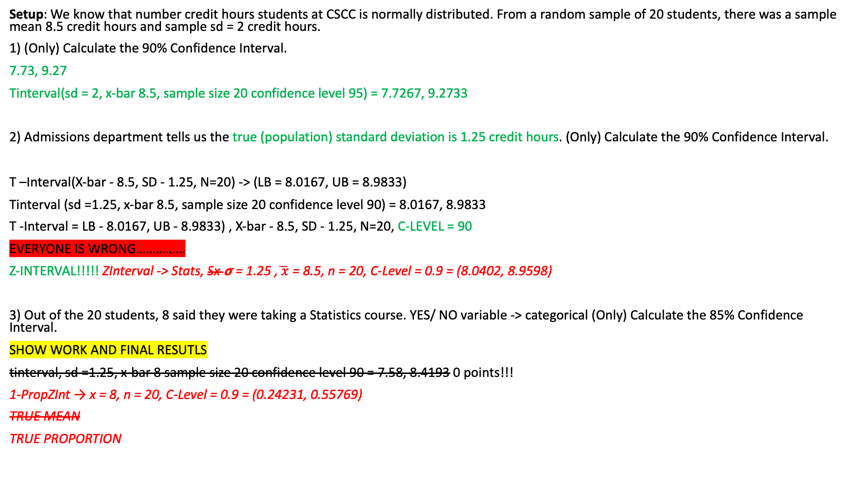


Summarizing LCQ
Setup: We know that number credit hours students at CSCC is normally distributed. From a random sample of 20 students, there was a sample mean 8.5 credit hours and sample sd = 2 credit hours.
1) (Only) Calculate the 90% Confidence Interval.
7.73, 9.27
Tinterval(sd = 2, x-bar 8.5, sample size 20 confidence level 95) = 7.7267, 9.2733
2) Admissions department tells us the true (population) standard deviation is 1.25 credit hours. (Only) Calculate the 90% Confidence Interval.
T –Interval(X-bar - 8.5, SD - 1.25, N=20) -> (LB = 8.0167, UB = 8.9833)
Tinterval (sd =1.25, x-bar 8.5, sample size 20 confidence level 90) = 8.0167, 8.9833
T -Interval = LB - 8.0167, UB - 8.9833) , X-bar - 8.5, SD - 1.25, N=20, C-LEVEL = 90
EVERYONE IS WRONG……………
Z-INTERVAL!!!!! ZInterval -> Stats, Sx 𝞂 = 1.25 ,$\overline{ x}$ = 8.5, n = 20, C-Level = 0.9 = (8.0402, 8.9598)
3) Out of the 20 students, 8 said they were taking a Statistics course. YES/ NO variable -> categorical (Only) Calculate the 85% Confidence Interval.
SHOW WORK AND FINAL RESUTLS
tinterval, sd =1.25, x-bar 8 sample size 20 confidence level 90 = 7.58, 8.4193 0 points!!!
1-PropZInt → x = 8, n = 20, C-Level = 0.9 = (0.24231, 0.55769)
TRUE MEAN
TRUE PROPORTION

Slide 21
Summarizing LCQ
Setup: We know that number credit hours students at CSCC is normally distributed. From a random sample of 20 students, there was a sample mean 8.5 credit hours and sample sd = 2 credit hours.
1) (Only) Calculate the 90% Confidence Interval.
2) Admissions department tells us the true (population) standard deviation is 1.25 credit hours. (Only) Calculate the 90% Confidence Interval.
3) Out of the 20 students, 8 said they were taking a Statistics course. (Only) Calculate the 85% Confidence Interval.

Slide 22
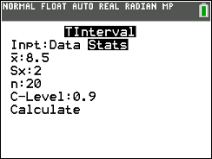
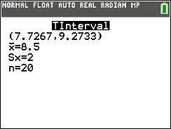
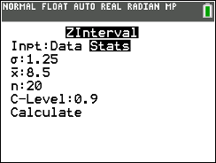
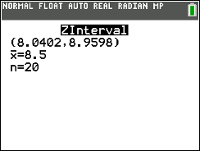
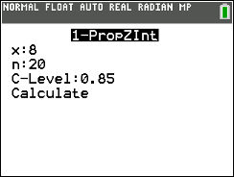
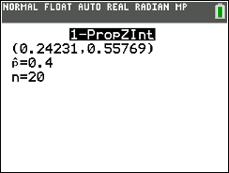
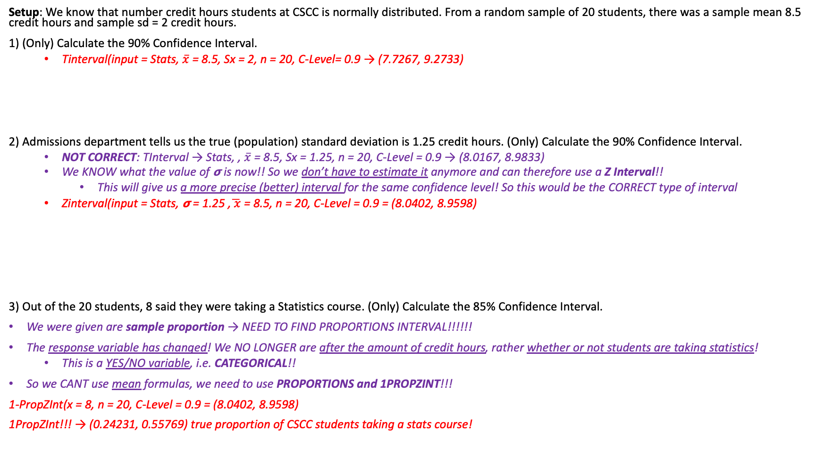
LCQ
*** Need to be able to recognize which type of interval to make! To help, first think about the response variable (or the parameter of interest)!
Mean 𝜇 or proportion p?? (Quantitative or Qualitative)
Then think about what information you have, what you need, and what to type in calc!
Setup: We know that number credit hours students at CSCC is normally distributed. From a random sample of 20 students, there was a sample mean 8.5 credit hours and sample sd = 2 credit hours.
1) (Only) Calculate the 90% Confidence Interval.
Tinterval(input = Stats, $\overline{x}$ = 8.5, Sx = 2, n = 20, C-Level= 0.9 → (7.7267, 9.2733)
2) Admissions department tells us the true (population) standard deviation is 1.25 credit hours. (Only) Calculate the 90% Confidence Interval.
NOT CORRECT: TInterval → Stats, , $\overline{x}$ = 8.5, Sx = 1.25, n = 20, C-Level = 0.9 → (8.0167, 8.9833)
We KNOW what the value of 𝞂 is now!! So we don’t have to estimate it anymore and can therefore use a Z Interval!!
This will give us a more precise (better) interval for the same confidence level! So this would be the CORRECT type of interval
Zinterval(input = Stats, 𝞂 = 1.25 ,$\overline{ x}$ = 8.5, n = 20, C-Level = 0.9 = (8.0402, 8.9598)
3) Out of the 20 students, 8 said they were taking a Statistics course. (Only) Calculate the 85% Confidence Interval.
We were given are sample proportion → NEED TO FIND PROPORTIONS INTERVAL!!!!!!
The response variable has changed! We NO LONGER are after the amount of credit hours, rather whether or not students are taking statistics!
This is a YES/NO variable, i.e. CATEGORICAL!!
So we CANT use mean formulas, we need to use PROPORTIONS and 1PROPZINT!!!
1-PropZInt(x = 8, n = 20, C-Level = 0.9 = (8.0402, 8.9598)
1PropZInt!!! → (0.24231, 0.55769) true proportion of CSCC students taking a stats course!

Slide 23






MAKE THIS NICER LATER!!
Flow chart decision process

Slide 24
When do I use which? p vs Z vs. t
Use 1 Proportion Z Interval when…
You are asked to find a Confidence interval for a Population Proportion
Dealing with Proportions (i.e. a success or failure)
Use T Interval when...
You are asked to find a Confidence interval for a Population Mean
This applies to estimating the population mean, not proportion
There is no “success” or “failure” being measured.
Generally always the population standard deviation will be unknown!
Use Z Interval only for…
(Very uncommon) Finding a CI for a Population mean when the population standard deviation is known.
As always, think about what is being measured for each observation/individual!
USE THE CORRECT NOTATION AND FORMULAS!!!!

Slide 25
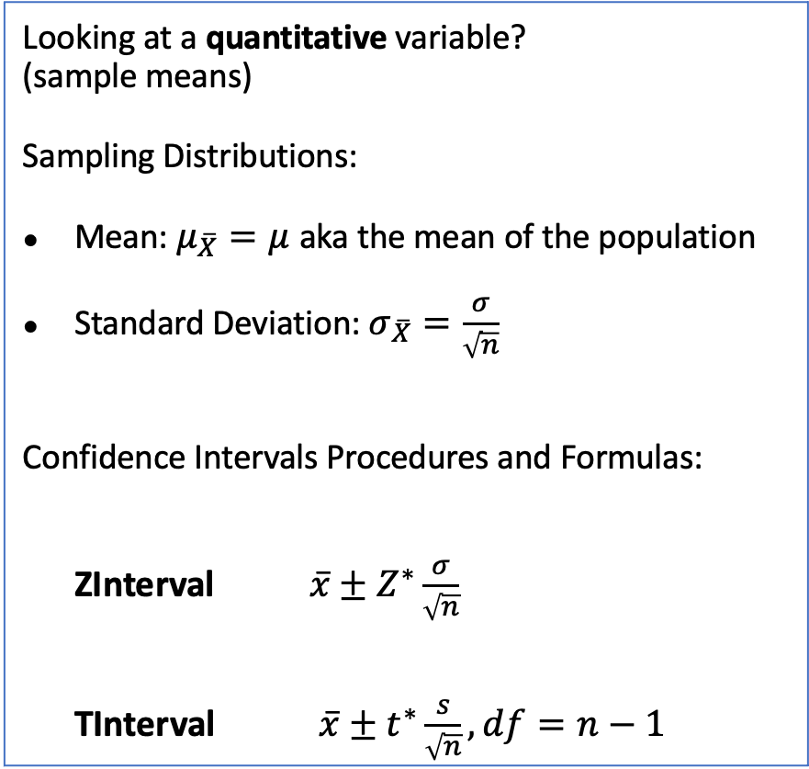
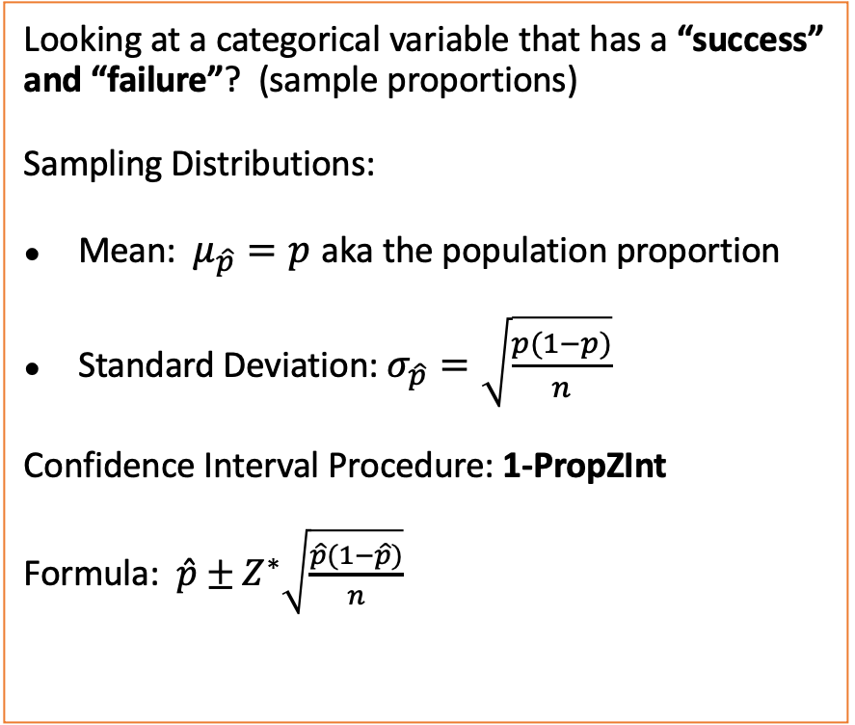
Means vs. Proportions: When do I use which formulas?
Looking at a categorical variable that has a “success” and “failure”? (sample proportions)
Sampling Distributions:
Mean: $μ_{\hat{p}}=p$ aka the population proportion
Standard Deviation: $σ_{\hat{p}}=\sqrt{\frac{p(1−p)}{n}}$
Confidence Interval Procedure: 1-PropZInt
Formula: $\hat{p}±Z^{∗}\sqrt{\frac{\hat{p}(1−\hat{p})}{n}}$
Looking at a quantitative variable? (sample means)
Sampling Distributions:
Mean: $μ_{\overline{X}}=μ$ aka the mean of the population
Standard Deviation: $σ_{\overline{X}}=\frac{σ}{\sqrt{n}}$
Confidence Intervals Procedures and Formulas:
ZInterval $\overline{x}±Z^{∗}\frac{σ}{\sqrt{n}}$
TInterval $\overline{x}±t^{∗}\frac{s}{\sqrt{n}}, df=n−1$

